Slide 1
Nuts and BOLTS of MLOps
MLOps 101
Srivatsan Srinivasan

Slide 2
agenda
Overview of Machine learning lifecycle
Challenges with ML Systems
What is MLOps?
How MLOps is different from DevOps?
MLOps Automated Pipelines and Components
Key Outcomes from MLOps

Slide 3
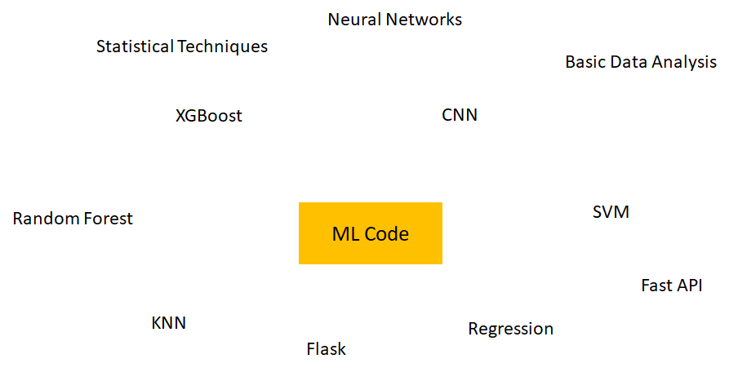
Machine learning - what do we see

Slide 4
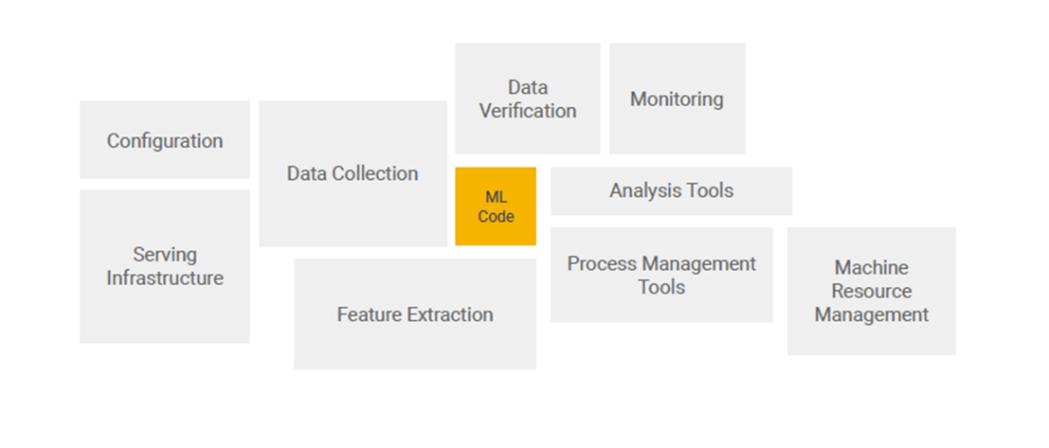
Machine learning - Real world ml systems
Source - https://papers.nips.cc/paper/2015/file/86df7dcfd896fcaf2674f757a2463eba-Paper.pdf

Slide 5
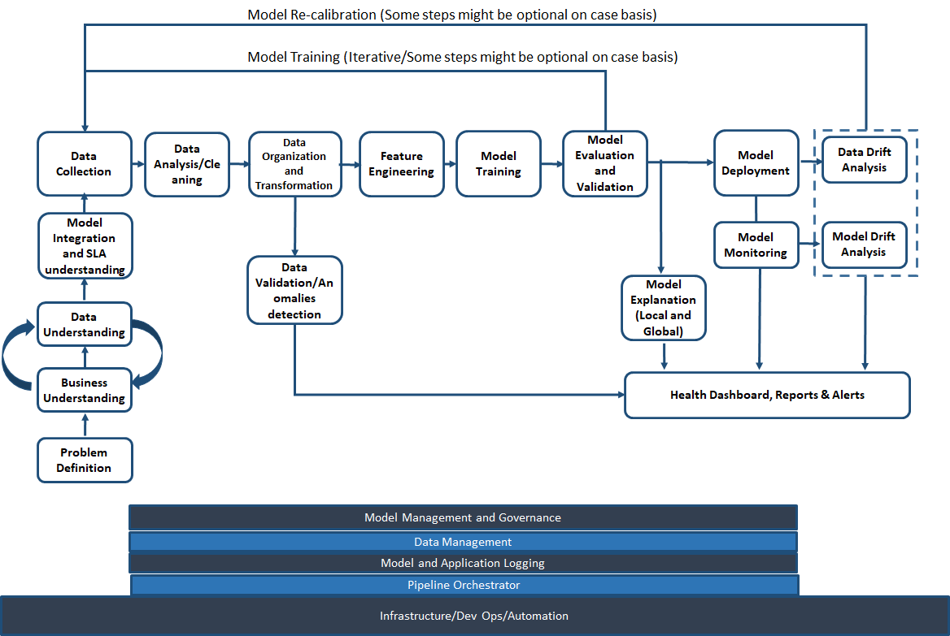
Real world ML process

Slide 6
Challenges with ML during development
Development, training and deployment environment can be different
Tools, libraries and dependencies can complicate deployment
Tracking and analyzing experiment can become tedious to handle
Difficult to reproduce experiment as input data changes
ML Code end up in a spaghetti jungle

Slide 7
Challenges with ML in production
Live data is not equal to training data
Feature engineering pipeline must match between training and serving infrastructure
Seamlessly scale up and scale down deployed model
Continuous training and champion challenger model deployment
Different technology landscape between development and deployment

Slide 8
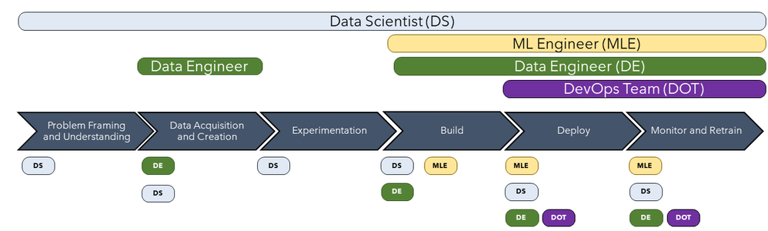
Challenges with people and process in ML
Skill mismatch between Data Engineers, Data Scientist and Software/DevOps Engineers
Image Source - https://techcommunity.microsoft.com/t5/azure-ai/mlops-is-not-enough/ba-p/1386789

Slide 9
What is MLOps?

Slide 10
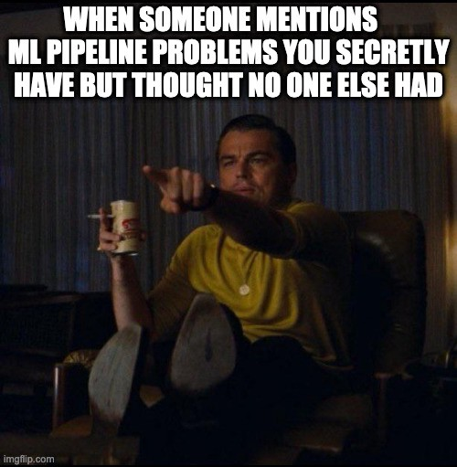
MLOps is not about throwing a product and everything is fine

Slide 11
What is MLOps?
MLOps in simple term is DevOps for Machine Learning
MLOps enables data science (data engineers and ML engineers) and IT teams (Software and Infra engineers) to collaborate and increase pace at which ML models can be developed, deployed, scaled, monitored and re-trained

Slide 12
“Practicing MLOps means that you advocate for automation and monitoring at all steps of ML system construction, including integration, testing, releasing, deployment and infrastructure management”
Google

Slide 13
How MLOps is different from devOps?
Data/Schema versioning apart from code versioning
Exprementation tracking (Model hyperparameters, Data Distribution, Model performance, feature importance etc)
Model artifacts versioning
Monitor continuously for data and model drift
Continuous re-training of model
Capture sensitivity of key features to target

Slide 14
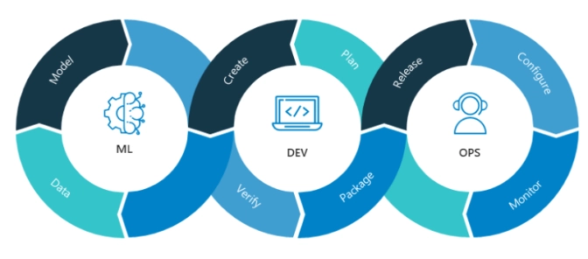
How MLOps is different from devOps?
Image Source: Nvidia

Slide 15
ML + DevOps
CI - Build, Test and validate code + data + schema + models
CD - ML Training Pipeline + (or) Serving Component
CT - Automatically re-train and serve the model

Slide 16
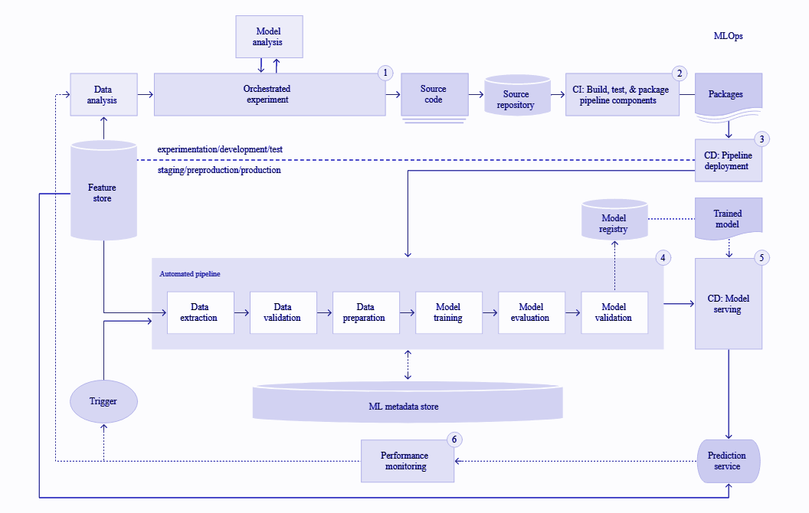
MLOps Automated pipeline and components

Slide 17
Key outcomes of MLOps
Model Reproducibility
Model deployment
Model Packaging and Validation
Model Explainability, Monitoring and Re-training
Model Portability
Model meets functional and latency requirement
Track and Manage Assets
Enable Collaboration ( data and code)
Seamlessly and Rapidly deploy model
Scale and A/B test models
Model behavior meets set standard
Track and Monitor Models
1
2
3
4

Slide 18
References
https://cloud.google.com/solutions/machine-learning/mlops-continuous-delivery-and-automation-pipelines-in-machine-learning
https://blogs.nvidia.com/blog/2020/09/03/what-is-mlops/
https://azure.microsoft.com/mediahandler/files/resourcefiles/mlops-infographic/MLOps%20Infographic.pdf

Slide 19
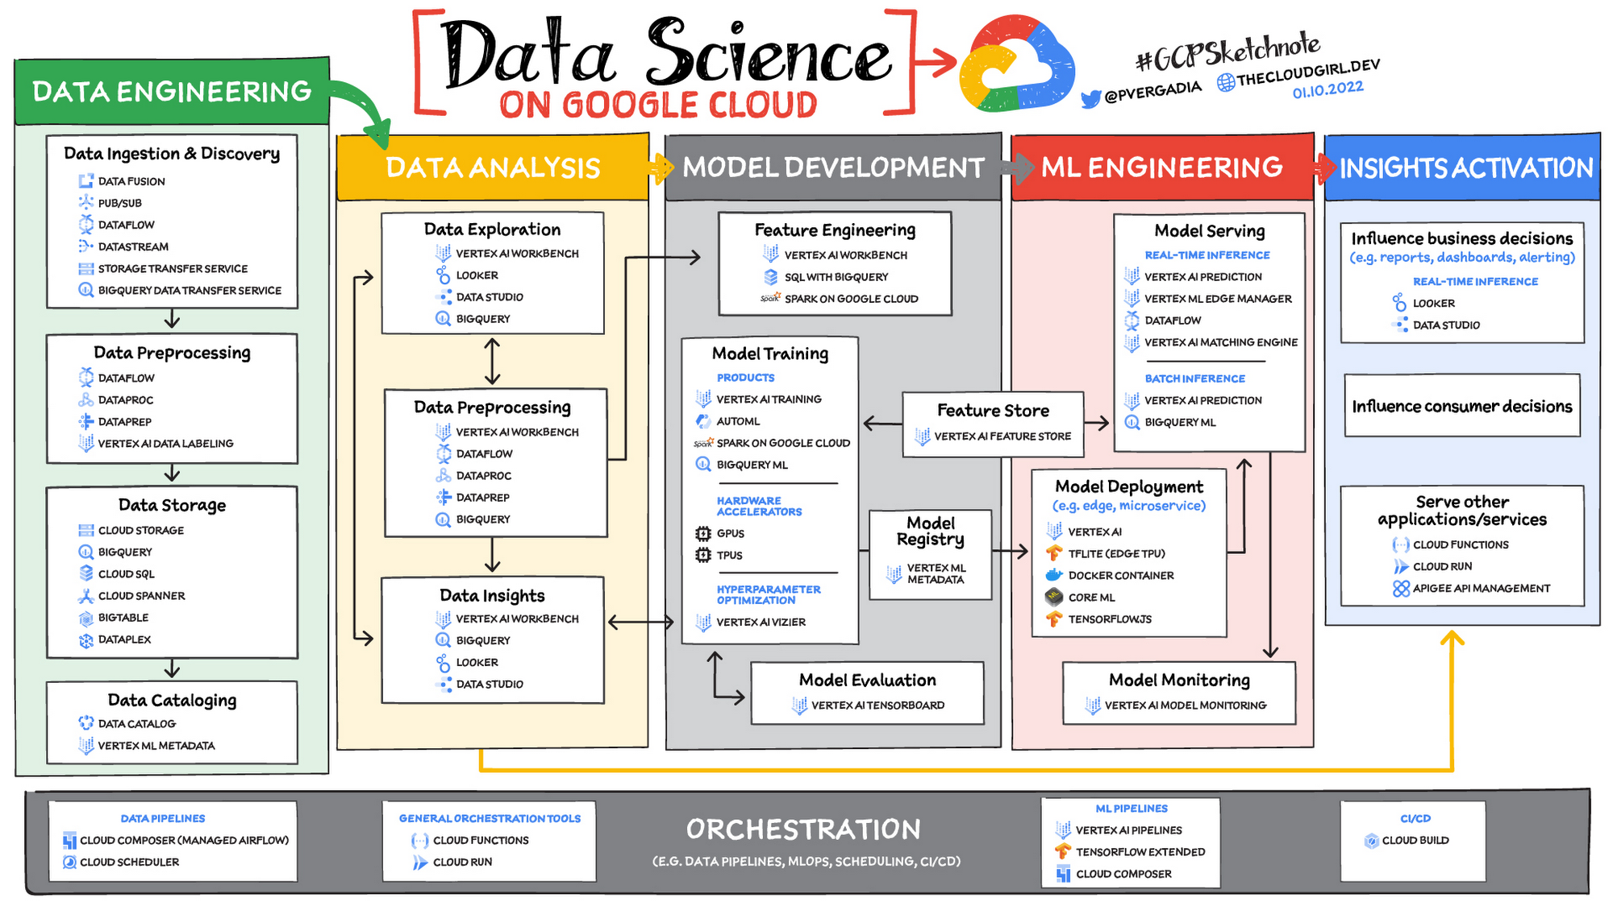

Slide 20
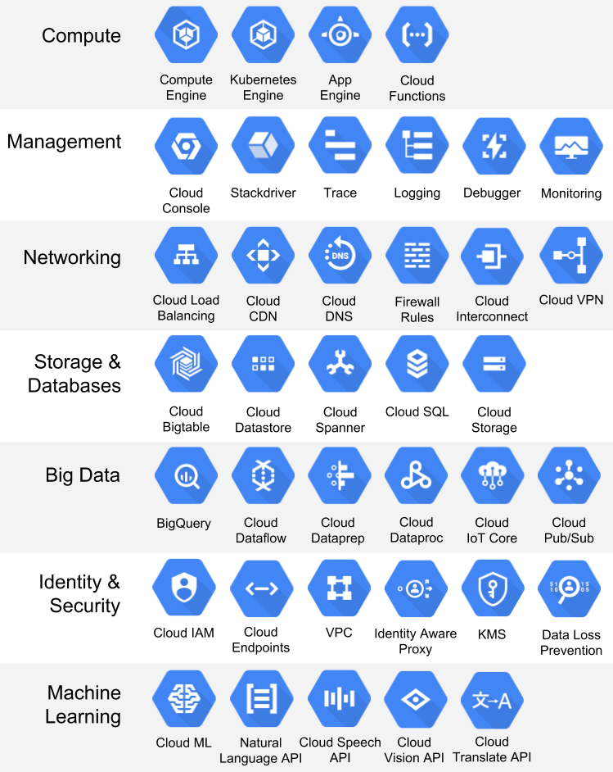

Slide 21
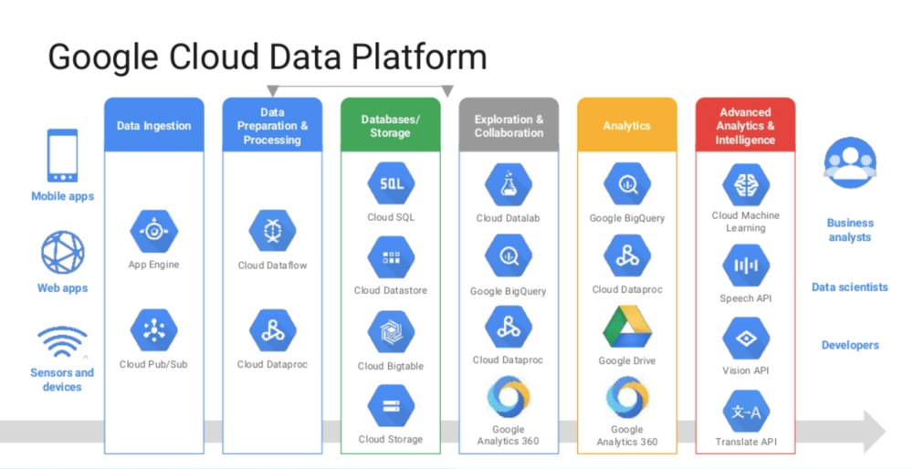

Slide 22
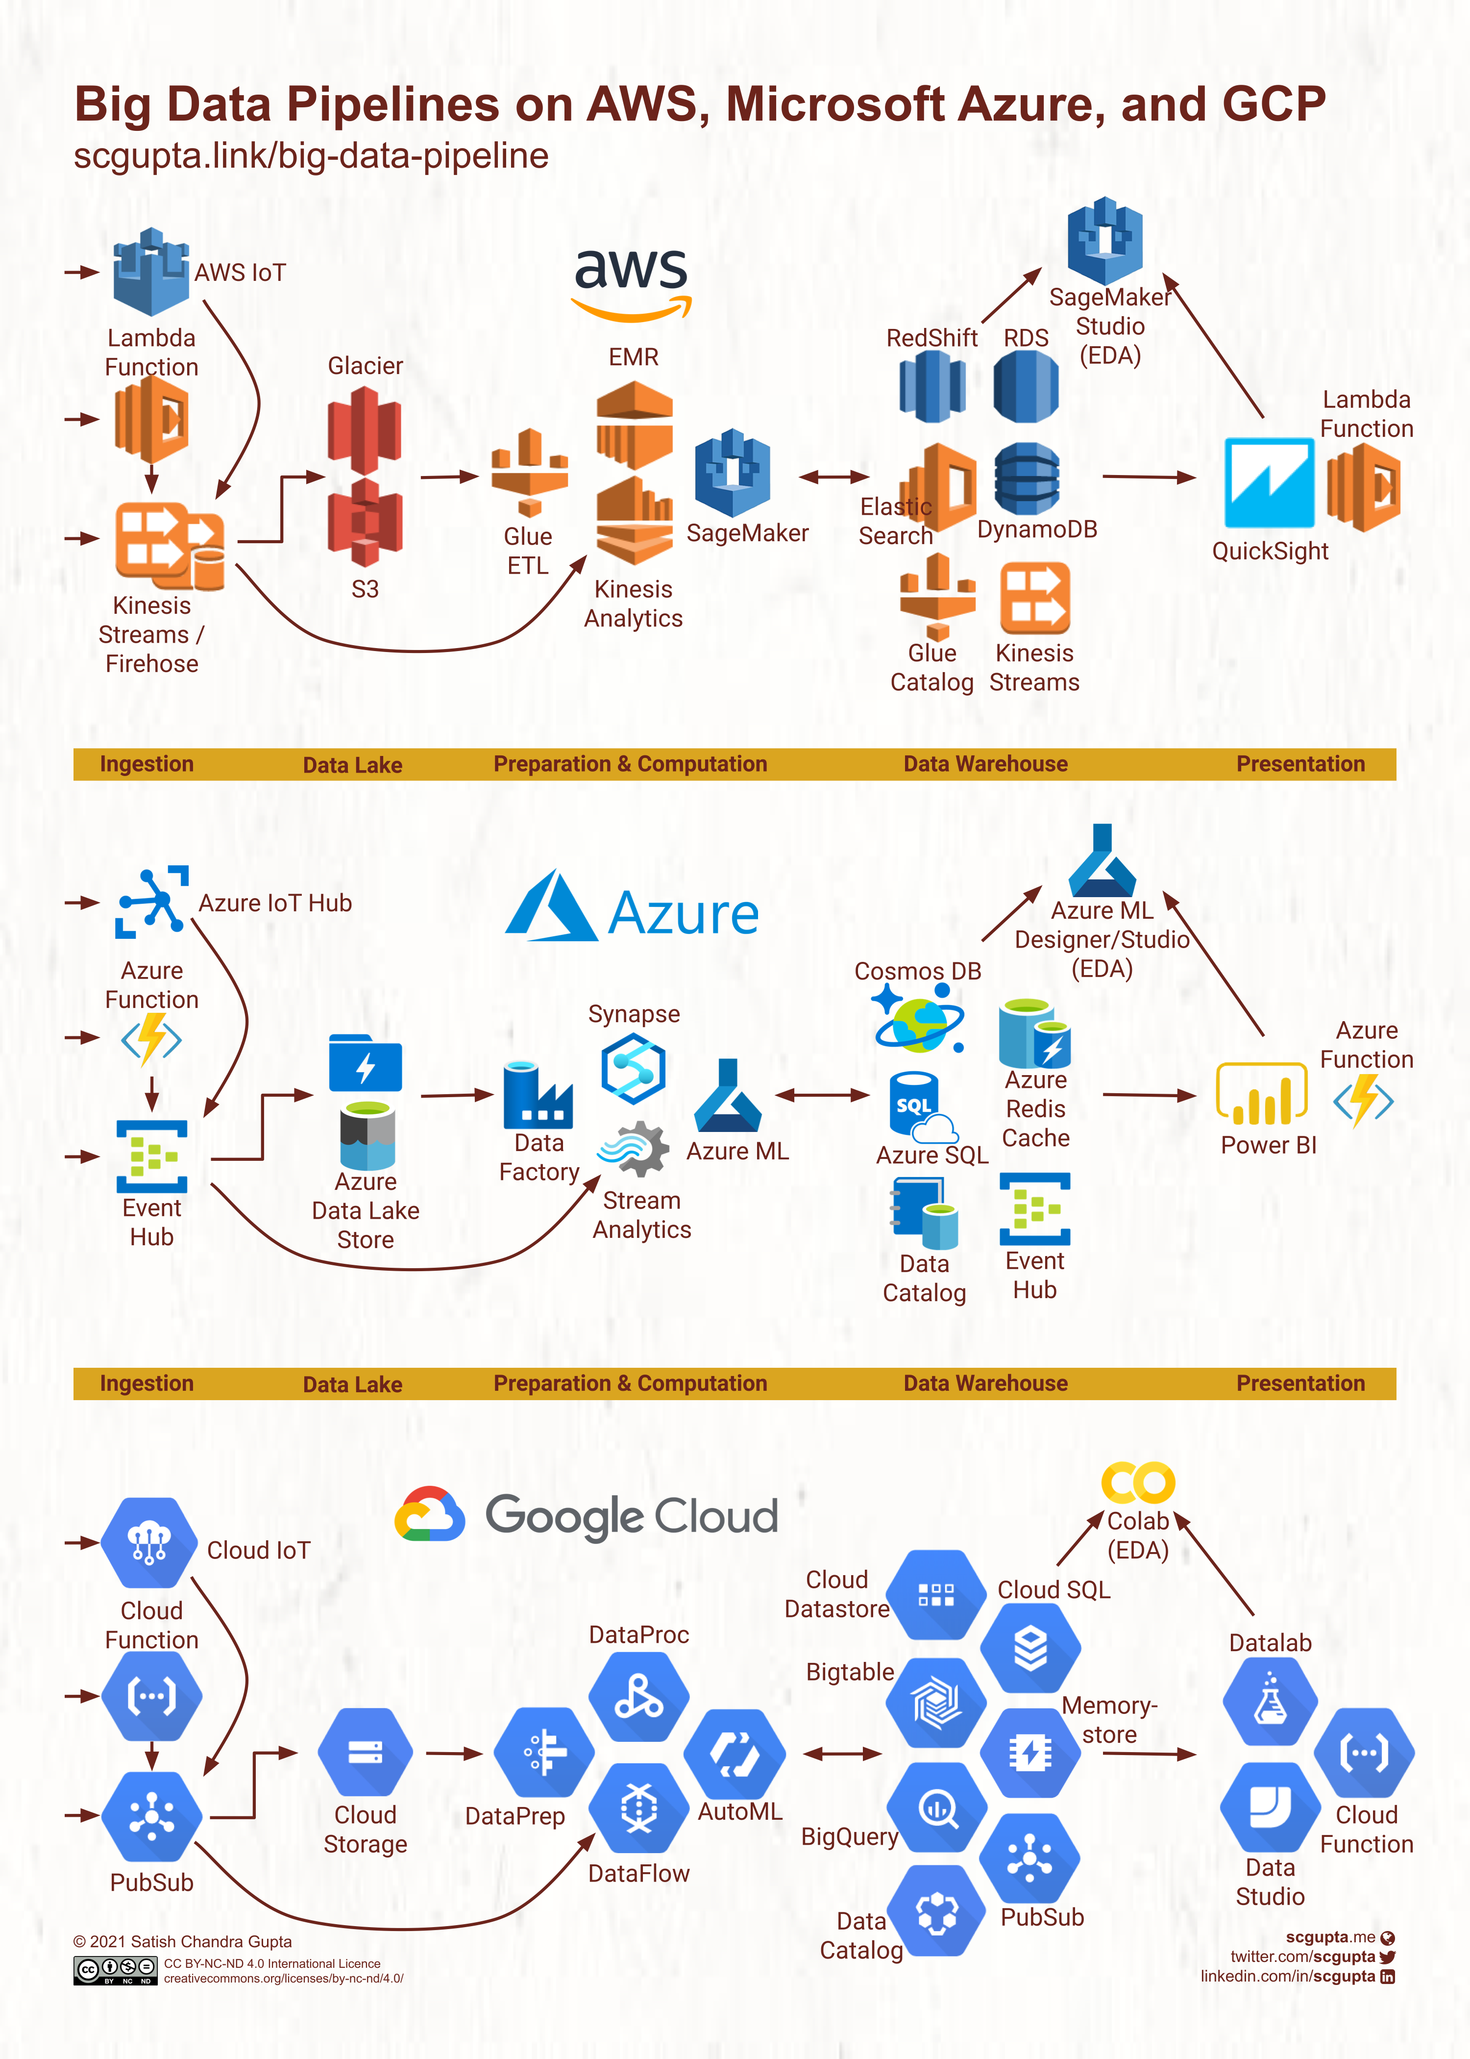

Slide 23
